Slide 1

Fruit Slicing Game Using Opengl 3.3
CSE 4208
Presented To:
Dr. Sk. Md. Masudul Ahsan
Professor
Department of Computer Science and Engineering
Md. Badiuzzaman Shuvo
Lecturer
Department of Computer Science and Engineering
Presented By:
Syed Nafisur Rahman Shuvro
Roll: 1907064
4th year
2nd semester
Khulna University of Engineering & Technology, Khulna-9203
Bangladesh

Slide 2
Outline
Introduction
Keyboard Control
Feature
Project Video

Slide 3
Introduction
Here, Opengl 3.3 is used to simulate the Fruit Slicing Game.
In this game, main objective is to cut the watermelon with the knife.
There will be three chances. By missing the fruit, one chance will be deducted.
Lighting, shading, texturing are used to enhance the relativity of the simulation.

Slide 4
Keyboard Control (Lighting)
Key 1: Toggle between different directional light configurations (dirlight1, dirlight2, dirlight3). Key 2: Pointlight turn on or off. Key 3: Spotlight turn on or off. Key 4: Toggle ambient light for all active lights on or off. Key 5: Toggle diffuse light for all active lights on or off.
Key 6: Toggle specular light for all active lights on or off.

Slide 5
Keyboard Control (View)
• Press W: Camera Forward
• Press S: Camera Backward
• Press A: Camera Left
• Press D: Camera Right
• Press UP: Knife up
• Press LEFT: Knife left
• Press DOWN: Knife down
• Press RIGHT: Knife right
• Press C: Pitch up
• Press X: Pitch down
• Press Y: Yaw left
• Press U: Yaw right
• Press Q: Roll left
• Press E: Roll right
• Press K: Game Restart
• Press G: Move the Knife

Slide 6
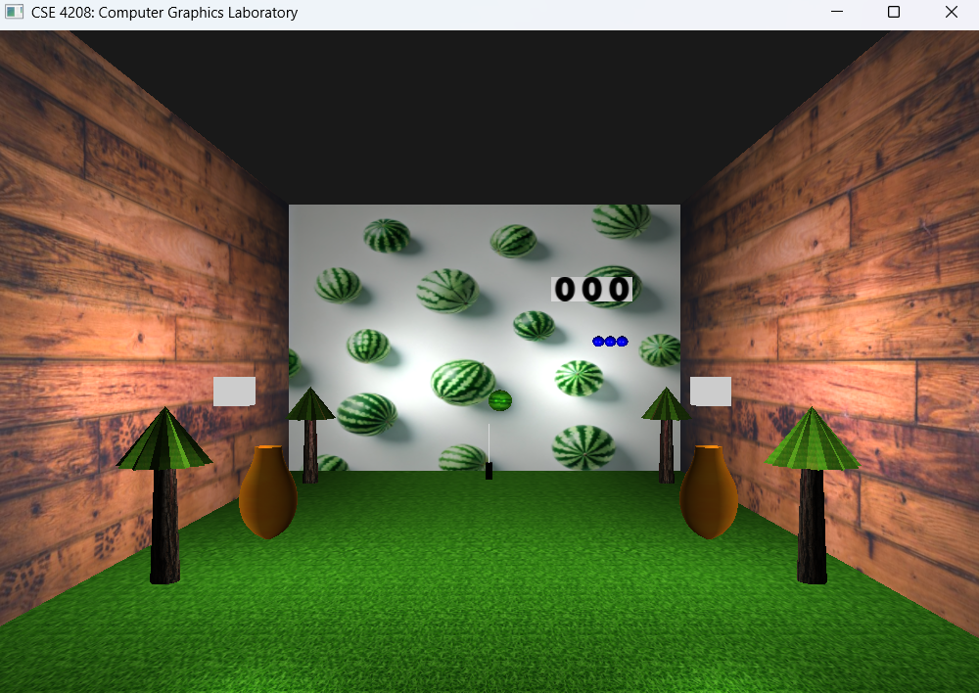
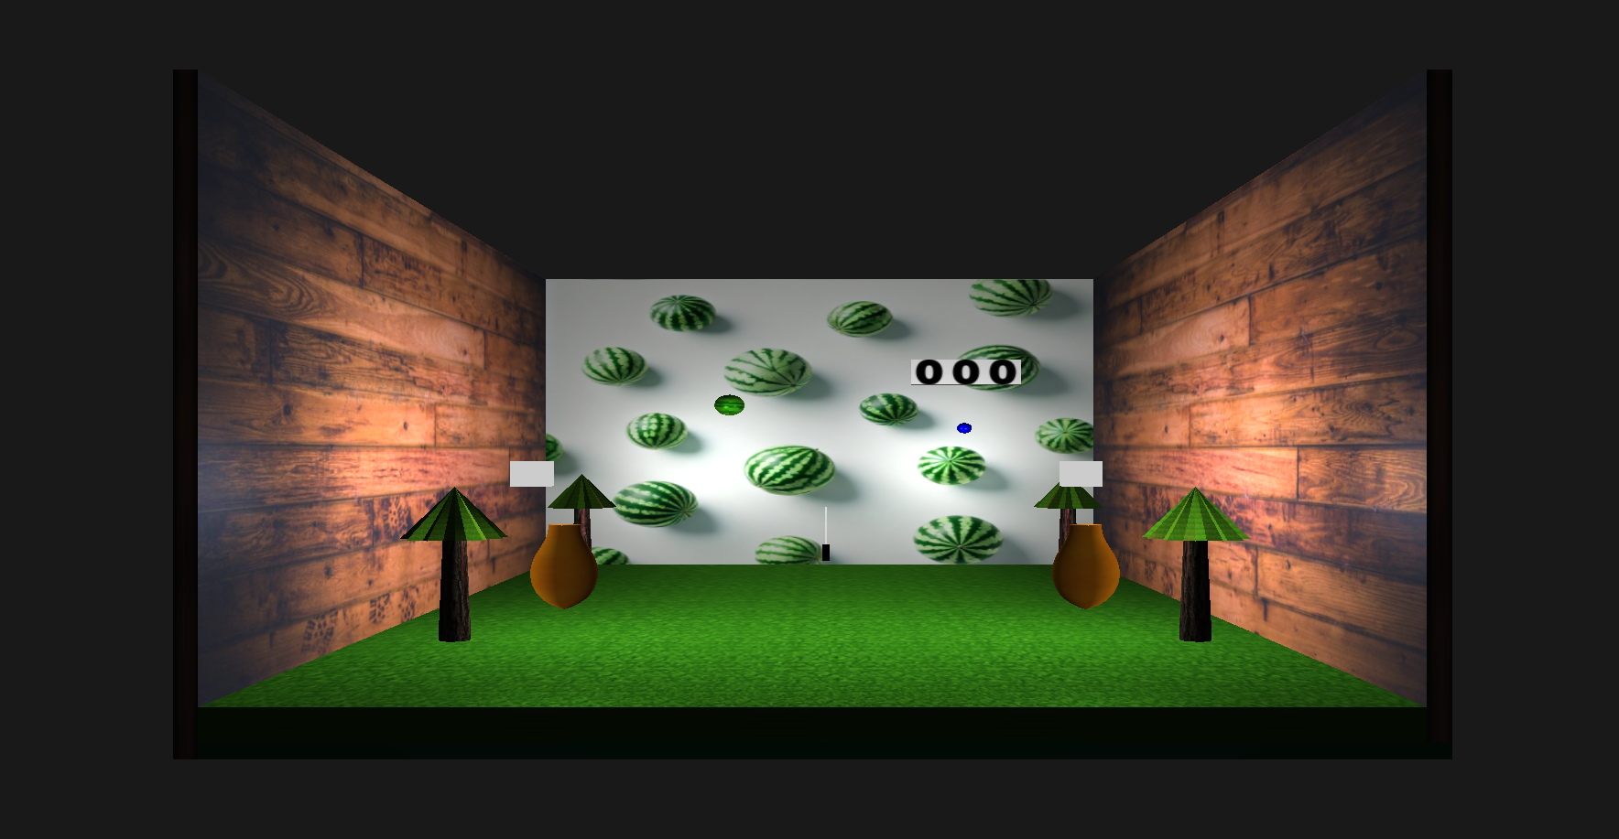
Features
Fig-1: Overview from different angle

Slide 7
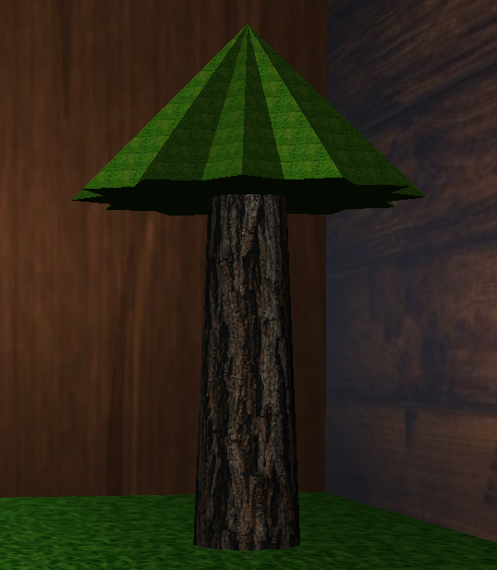
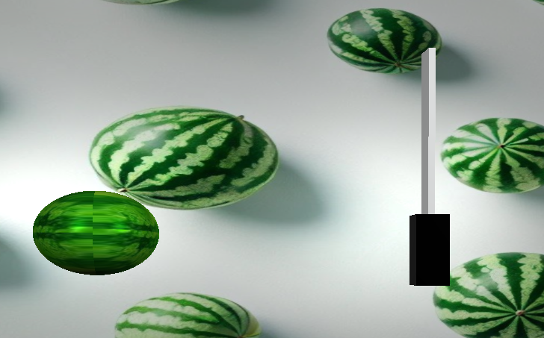
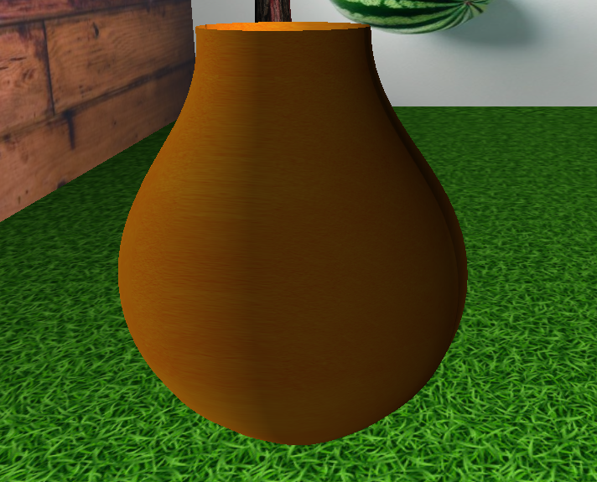
Features (cont’d)
Fig-2: Different objects

Slide 8
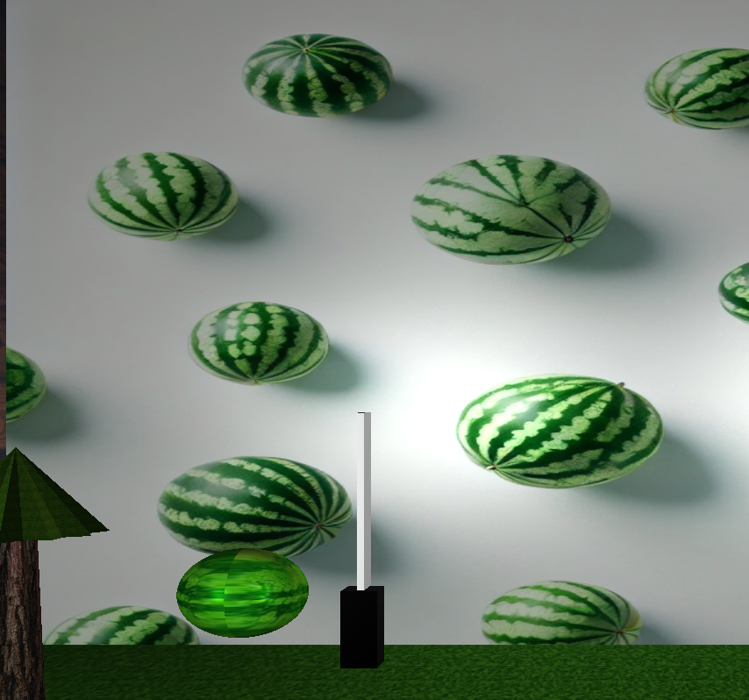
Features (cont’d)
Moving Objects: 2 kind of moving objects.
Knife
Watermelon
Fig-3: Moving Objects

Slide 9
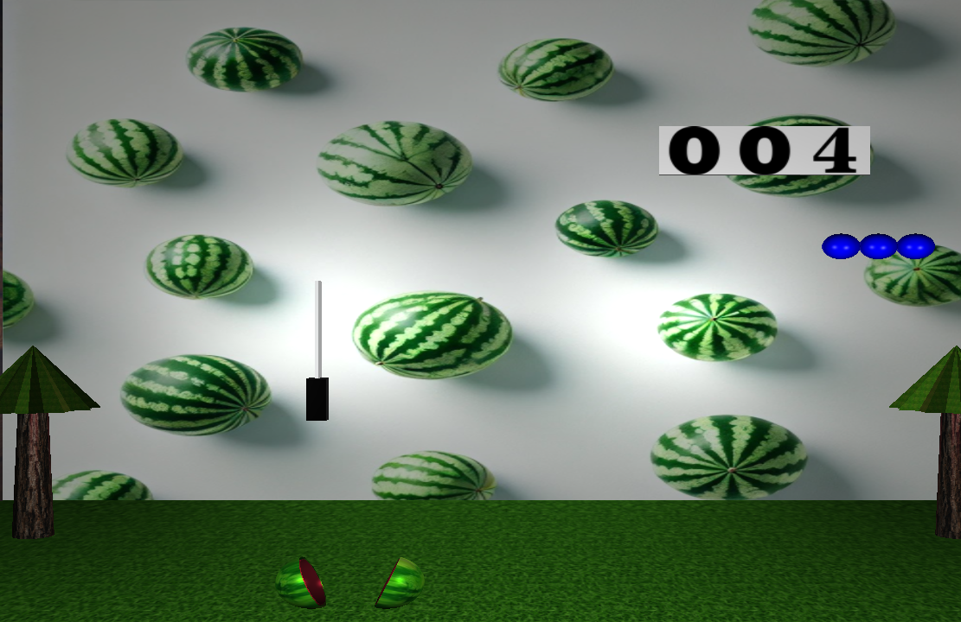
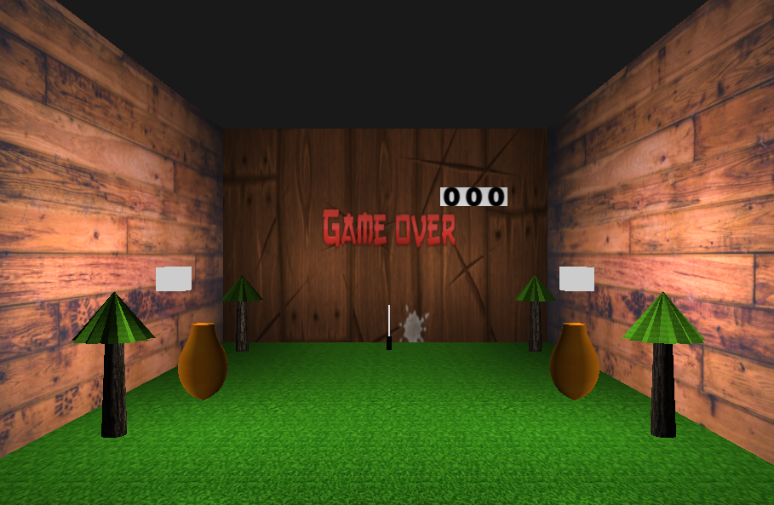
Features (cont’d)
Fig-4: Scene after cutting the melon
Fig-5: After game over

Slide 10

Project Video
Fig-7: Project Video

Slide 11
References
Lecture Provided in the classes
Provided lecture sheets
https://learnopengl.com/

Slide 12
Thank You

